Slide 1
My Journal To Python
Name: 麥聖嬰
Teacher: My Dear Great Teacher

Slide 2
AGENDA
Python
Input and output: input() and print()
Data types: numerisc, strings, list , dict
Operators ON data type:

Slide 3
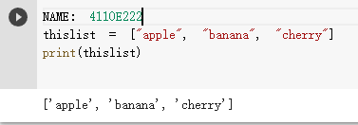
Data Types : Python Lists
Lists are used to store multiple items in a single variable.
Lists are one of 4 built-in data types in Python used to store collections of data, the other 3 are Tuple, Set, and Dictionary, all with different qualities and usage.
Lists are created using square brackets:
square brackets []

Slide 4
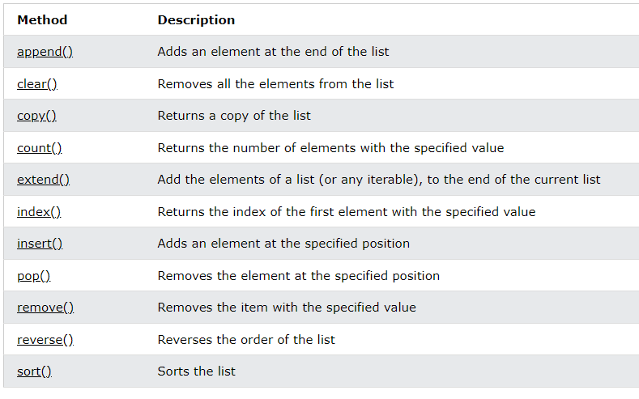
LIST METHOD

Slide 5
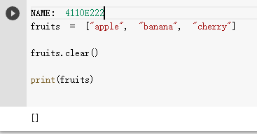
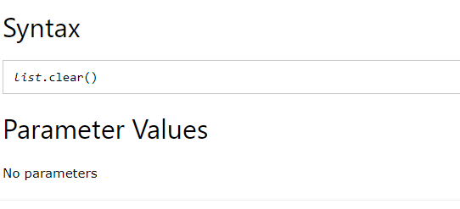
Python List clear() Method

Slide 6
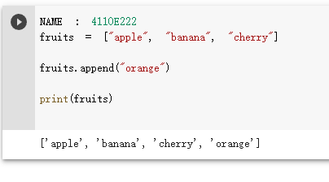
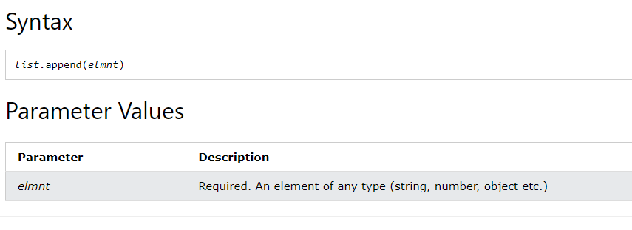
Python List append() Method

